Slide 1

Welcome to:
Pre-Field Orientation

Slide 2

Pre-Field Orientation Live Question & Answer Session:
Thursday, February 18th
1:00 pm to 3:00 pm
Write down your questions as you watch the orientation materials.
Bring your questions to the Q&A and receive answers!

Slide 3

Introduction to your
Field Education

Slide 4
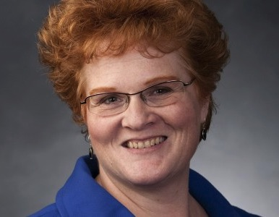
FIELD DIRECTOR:
Wendy W. Sheffield, LCSW
Oversees the Field Education Curriculum
Final Decision on Placements and Grades
Teaches Integrative Field Seminars

Slide 5
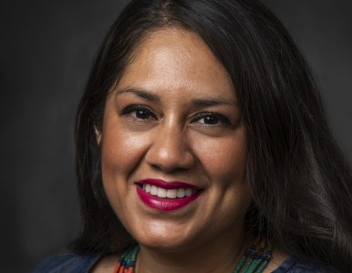
Field Liaison:
Ruth Aguirre, LCSW
In-Agency Field Visits each Semester with Student and Field Instructor
Teaches Integrative Field Seminars
First Contact for Internship Problems

Slide 6
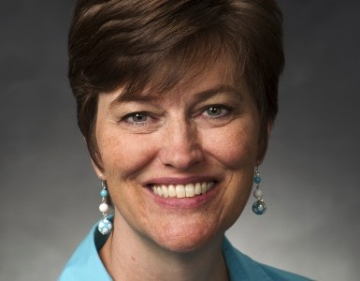
Administrative Manager:
Charlene Clark
Administers the AmeriCorps Program
Organizes Us
Makes Us Look Good
Carefully read, with attention to detail, EACH & EVERY email she sends you

Slide 7
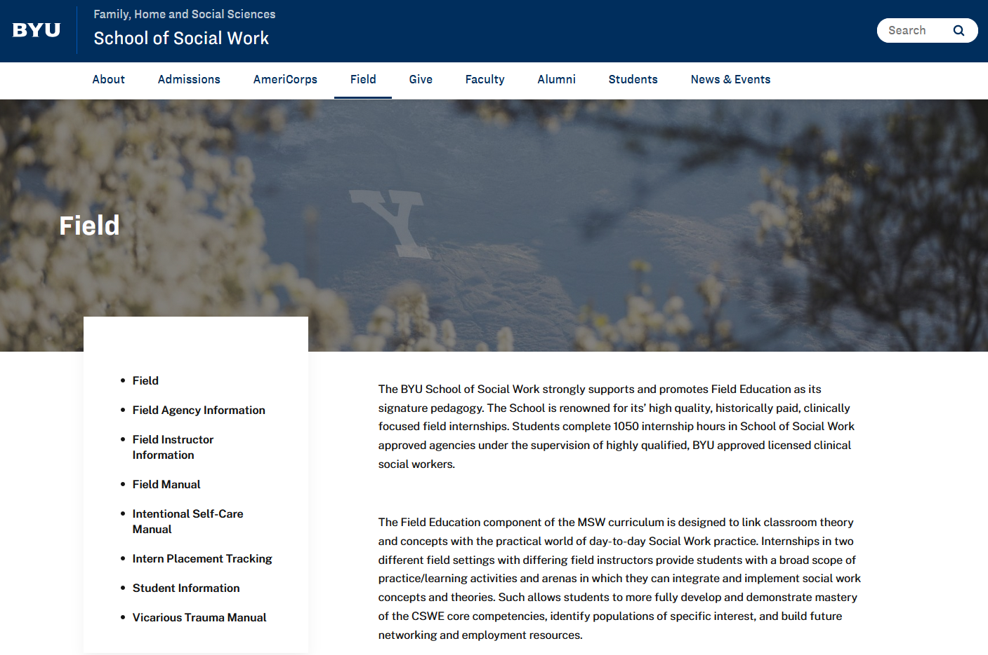
BYU School of Social Work Field Manual
You are responsible for ALL of the information found in the MSW Field Manual.
https://socialwork.byu.edu/field

Slide 8
Mandatory Field Orientations:
Online Video & Live Q&A Session
  BYU Field Team
  Basic Field Requirements
  Internship Contacts that Need to be Made Prior to the start of the Semester.
  Field Courses
  Scheduling
  Registration Tasks
  AmeriCorps Orientation
1st Day of Sp/Sum Semester
  Field Roles and Systems
  Syllabus Review
  Field Paperwork Review
  Safety Training
  Internship Orientation
  Introduction to Self-Care Curriculum
  Normal Field Flow & Learning Curve
  Use of Supervision
  Professionalism
At least once each semester you will have a Large Group Integrative Field Seminar; usually the first week of each semester.
Please check your Syllabi for date, time, and place of these Seminars and make sure you are in attendance!

Slide 9
Scheduling
Spr/Sum: Tuesday, April 27, 2021 to Friday, August 13, 2021
Tues, 4/27, On-Campus all day; Wed, 4/28, 1st day in Internship Agency
Fall/Winter: Monday, August 30, 2021 to Wednesday, April 13, 2022
Holidays/Vacations: arrange with your Field Instructor/supervisor
Class: During F/W Tuesdays and Thursdays are CLASS days (& nights)
Electives: Consider Internship Night Requirements when planning your schedule.
Starting Therapy: You can begin training activities before the first day of the semester, but you CANNOT begin therapeutic activities until April 28 (Sp/Sum) or August 30 (F/W).

Slide 10

Internship Courses - Registration
You will rotate having both Wendy & Ruth as IFS instructors.
Sp/Sum:
  Soc W 614R: Integrative Field Seminar 1 (2 credits)
  Soc W 654R: Field Internship 1 (4 credits)
F & W:
  Soc W 615R: Integrative Field Seminar 2 (1 credit each semester)
  Soc W 655R: Field Internship 2 (2 credits each semester)
NOTES:
  Soc W 614R: 1 hour in-class & 1 hour online Self-Care Curriculum
  Soc W 615R: 1 hour class
  These count as Internship Hours OVER your 450/600 Hours
  Soc W 654R: 450 hours in agency required. M-F; 28-40 hours/week; 14 weeks
  Soc W 655R: 600 hours in agency required. MWF; 20 hours/week; 15 weeks each semester

Slide 11
Integrative Field Seminar (IFS)
(Soc W 614R/615R) Sections
Assigned. See handout. Keep for future reference.
IFS Locations:
Sp/Sum, Fall & Winter
Wendy’s in 2198 JFSB
Ruth’s in B132 JFSB
On-Campus (Zoom allowed for COVID-19 related health, pre-notification required by 7:00 am the day of class)

Slide 12
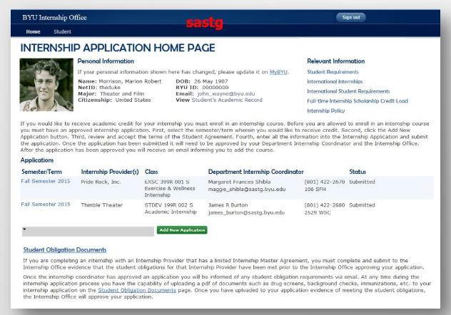
IRAMS
IRAMS: Internship Registration and Management System
Experience.byu.edu>students
Separate applications for Spring, Fall and Winter – you will do this three times!
Follow instructions: https://brightspotcdn.byu.edu/c4/86/4ef8468d45c4991414c0bdca3201/irams-instructions-studentsdecember2018.pdf (this includes instructions for multiple internship applications (page 6) AND repeating a previous internship (page 7))
Internship Provider information: (found on IPT, hover over placement)
Start/End dates:
  Spring: April 27, 2021; August 13, 2021
  Fall: August 30, 2021; December 17, 2021
  Winter: January 3, 2022; April 13, 2022
Describe the internship opportunity:
Internship class: Spring: Soc W 654R (instructor Charlene Clark); Fall and Winter: Soc W 655R (instructor Charlene Clark)
Faculty Mentor: Wendy Sheffield
Are you enrolling in another BYU course for this same internship? Yes
Soc W 614R (Spring); Soc W 615R (Fall/Winter)
Student Obligations: IHC, Utah Department of Corrections

Slide 13
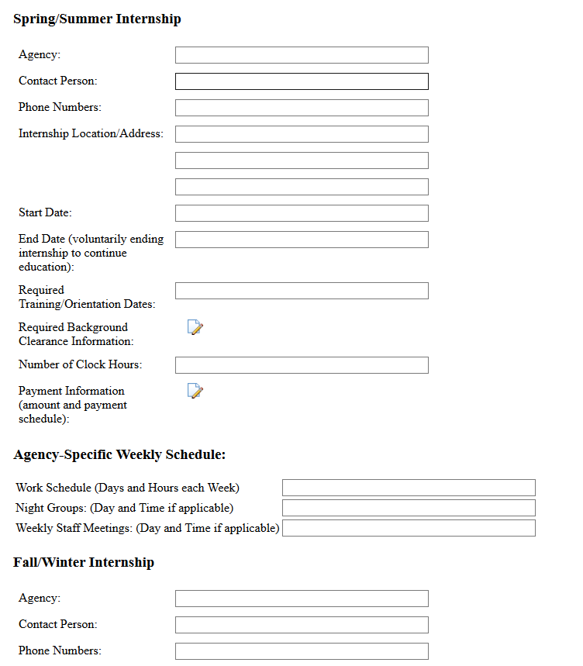
MSW Field Internship Contact Form
Due April 5, 2021
Information for BOTH Spring/Summer and Fall/Winter internships required.
You need to know when Large Group Orientations are scheduled
Reasons for:
  Having you complete this form
  Your entry of payment amount

Slide 14


How Do I Contact My Agency?
Professionalism
Be Prepared
Be Yourself

Slide 15

Agency Contacting Video
What NOT to do when contacting your agencies!
What things do you notice in the video that are things you do not want to say, do, or be doing when speaking with your future internship site?

Slide 16

Funding Opportunities
Do NOT work during your internship! (Highly recommended)
Paid Internship! Best funding source!
3 Minute Thesis Research Competition –
https://gradstudies.byu.edu/page/3mt%E2%80%94three-minute-thesis
Fulton Poster Competition - (Due late March/early April)
Shumway Paper – Fall semester (see handout in folder)
AmeriCorps – separate recording/orientation
FHSS Internship/Experiential Learning Grants
  Due Dates: March 15, November 15 and July 15 by midnight
  (http://fhssinternshipgrants.byu.edu/)
Requirements:
  Demonstrate need
  End of semester REPORT & High-Resolution Picture
  Timeliness

Slide 17

Examples

Slide 18
Examples of applications that did not get funded
Example 1:
Internship Compensation: $761 per month (stipend)
Current Monthly Expenses: $1,205
Current Monthly Resources: $1,081
Current Semester Expenses: $5,280
Current Semester Resources: $4,324
Total needed: $1,000
Where are the details???
$5,280-$4,324 does not = $1,000
If you are rounding on that, what else are you rounding on?
Example 2:
Internship Compensation: $14 per hour. Working 20 hours per week.
Current Monthly Expenses: $1750 per month
Current Monthly Resources: $1620 per month from internship pay part time student job.
Current Semester Expenses: $1750 per month
Current Semester Resources: $1620 per month
Total needed: $7,000
Not sure how we got to $7,000 needed? There are no details
Monthly and Semester should be different numbers. (Monthly x 4 = semester)
Monthly – Resources = $130 x 4 = $520 … not $7,000

Slide 19
Example 3:
Internship Compensation: $12.50/hour
Current Monthly Expenses: $3,000
Current Monthly Resources: $1,800
Current Semester Expenses: $12,000
Current Semester Resources: $8,500
Total needed: $3,500
Again, no details – Monthly expenses of $3,000 seems high.
Example 4:
Internship Compensation: About $10,000
Current Monthly Expenses: Rent: $400; Utilities: $25; Food: $200; Phone:$25; Car: $150; Tithing: $130; Misc: $100 = $1,030 total (1030x4=4120)
Current Monthly Resources: Internship 1: $1,400
Current Semester Expenses: Tuition: $7,000; Rent: $3,600; Utilities: $225; Food: $1,800; Phone: $225; Car: $1,350; Tithing: $1,170; Misc: $900 = $16,270
Current Semester Resources: Internship 2: $10,000 (18 hrs per week at $17 x 4 weeks x 9 months) Americorps: $1600 = 11,600 (total)
Total needed: About $4,600
Nothing adds up…

Slide 20
Example 5:
Internship Compensation: My work will be compensated with a $11.52/hour stipend for the first 500 hours, with the last 100 hours being voluntary service, for a total of 600 internship hours combined Fall/Winter.
Current Monthly Expenses: TOTAL: $3,835 ; Groceries: $300, baby: $465. Childcare: $800. Health/medical: $200; Rent: $1150; Internet: $50; Phone:$70; Gas/Car expenses: $140; Tithing/Fasts: $520, Other/personal: $140.
Current Monthly Resources: TOTAL: $5,156. ITEMS: Husband's paycheck, $4,000. Current internship (ending in August): $1,156.
Current Semester Expenses: TOTAL: $13,158. ITEMS: Living expenses (as itemized above in monthly, 3,835, plus $400 extra childcare, then multiplied by four months), $9,333. Books, $180; Tuition, $3,645
Current Semester Resources: TOTAL: $14,880. ITEMS: Husband's paycheck, $12,000. Internship: $2,880.
Total needed: $2,000
Income is more than expenses

Slide 21
Good Example
Example 6: (includes good details, demonstrates need)
Internship Compensation: $12 an hour for 600 hours equals about $7,200 (before taxes)
Current Monthly Expenses: Tithing $150 + Mortgage $1,779 + Car pmt/insurance $468 + Debt $897 + Utilities/Cell $814 + Spouse student loans $298 + Life Ins $30 + Braces/dance/cello $273 + Groceries $500 + Gas $350 = $5,535
Current Monthly Resources Internship $10.88/hour for no more than 29 hours a week, totaling $1262.08/month. My husband was laid off in March. Church assisting with mortgage and food.
Current Semester Expenses: Tithing $96 + Mortgage $1,779 + Car pmt/insurance $468 + Debt $897 + Utilities/Cell $814 + Spouse student loans $298 + Life Ins $30 + Braces/dance/cello $273 + Gas $362 + Fall Tuition $3,940 = $8,957
Current Semester Resources: Internship 2 $12/hour for 20 hours totaling $960/month. Church will continue to assist with food. Hoping and praying husband finds employment.
Total needed: Any amount to help in covering tuition and/or books would be very appreciated and help me continue earning this degree.

Slide 22

AmeriCorps

Slide 23

AmeriCorps To Do
Turn in Gold checklist
IPT Student Detail & Forms
Background check (Truescreen & Fieldprint)
Accept eGrants invitation

Slide 24
Internship To Do
Contact your field placement agencies
Complete Contact Form
Complete agency-specific background clearances
Identify and calendar in agency-specific training schedules
Complete IRAMS (Sprummer-2021, Fall-2021,
  & Winter-2022 Semesters)
Register for Internship Class
Register for Integrative Field Seminar
Read online BYU School of Social Work Field Manual
Attend Large Group Field Orientation on April 27th.

Slide 25
Large Group Field Orientation
1st Day of Sp/Sum Semester
Tuesday, April 27, 2021
9:00 am to 3:00 pm
207 MARB
Please bring a sack lunch.
We will ALL be meeting together!!

Slide 26


