Slide 1
1st Day of Field
Orientation
W
Welcome to Field!

Slide 2

Getting to Know You…
R
April 28
2021
In “Real-Time”…
Not Virtually!

Slide 3

I…
One thing your cohort members already “know about you” or “recognize you for.”
One thing none of your cohort members know about you.

Slide 4
Roles and Systems
W
Who’s who…

Slide 5
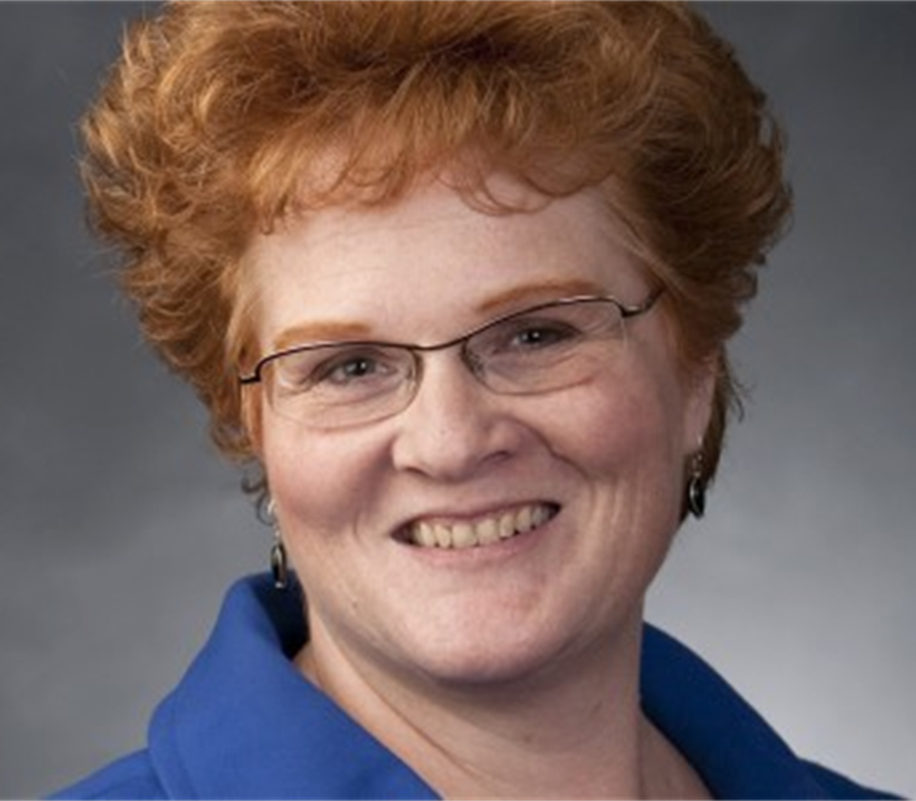
Wendy W. Sheffield, LCSW
Director of Field Education
The “Buck Stops Here”
Over-Sees Field Education
Policy Formulation & Oversight
Assigns Placements
Assigns Grades
Designs Field Education Curriculum
Writes Syllabi
Teaches half the Integrative Field Seminars
Scores IFS Monthly Reflections
First contact re. internship policies, field education “structural or programming” concerns

Slide 6
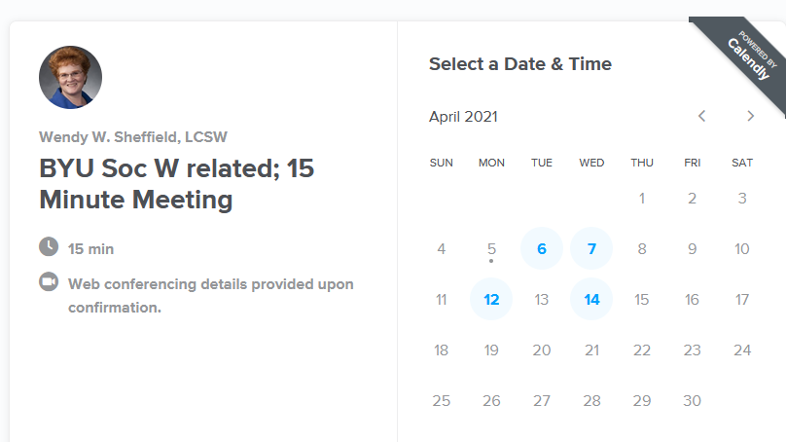
To Schedule an Appointment w/ Wendy:
https://calendly.com/wendysheffield/15min
Link in Field Syllabi, under “Classroom Procedures”
Available days/times automatically generated
When you sign up for an appointment, a zoom link is automatically created and sent to both you and I, and it is placed on my calendar.
Appointments must be scheduled 24 hours in advance.
Please cancel via the same link if needed.
In an emergency, email or call me…

Slide 7
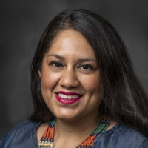
Ruth Aguirre, LCSW
Field Liaison
R
Provides feedback to Field Director re. progress, problems, strengths, grades, etc.
Visits at least once/semester with each student and FI in their internship agency.
Teaches half of the Integrative Field Seminars
Scores IFS monthly reflections
First contact re. in-agency internship concerns

Slide 8
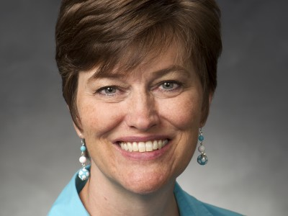
Charlene Clark,
Administrative Manager
C
Administers the AmeriCorps Program
Organizes Us
Makes Us Look Good
ALWAYS read with attention to details and immediately answer Charlene’s emails!
She won’t send you anything that is not important!
First contact re. IPT signatures & AmeriCorps questions

Slide 9
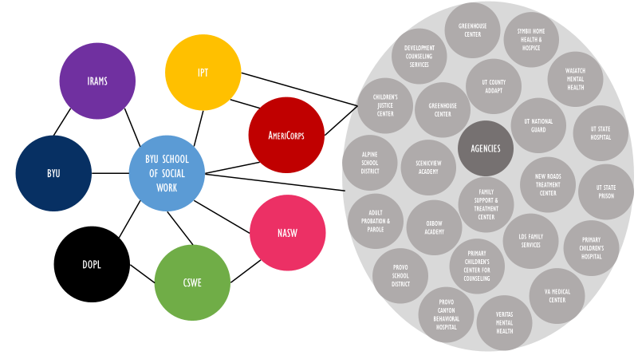
Systems we work with in the Field…
W

Slide 10
Field Education
Administrative Team Approach:
“The BYU School of Social Work Field Education Department utilizes an Administrative Team Approach. Information regarding your field internships, field performance, and anything that could/may potentially impact your internship attendance or performance will be shared with members of the Field team. The Field Education team consists of: The Director of Field Education, the Field Liaison, and the School of Social Work Program Manager. Weekly ongoing administrative assistance and support is provided by the School of Social Work Program Manager who attends Field Team meetings. If the Director of Field Education has a meaningful concern related to any Field Education related matter, such information may be shared with the Director of the School of Social Work. Narrative responses to Monthly Time and Reflection Logs may be read by either the Director of Field Education, the Field Liaison, or both.”

Slide 11
Field Education Administrative Mottos:
“We are Tough on Policies; Tender on People."
“We will only do for one client/student what we are willing to do for all.“

Slide 12
Council on Social Work Education
Our Internship requirements and curriculum are based on CSWE requirements
# of hours
Competencies
Supervision
Learning Agreements
Field Liaison
Linkage of classroom and field education components

Slide 13
MSW Handbook
MSW Field Manual
(Outline Policies & Procedures)
R
Check these 1st for any questions you may have!
(ie. Fingerprints may need be taken multiple times dependent on
which programs/agencies/certifications you are working with….)

Slide 14
So….
What do these mean for you personally?

Slide 15
Field Courses
C
Soc W 614R/615R (Integrative Field Seminar)
Soc W 654R (Field Internship 1)
Soc W 655R (Field Internship 2)

Slide 16
Internship Scheduling Guidelines
W
Internship 1 (Sp/Sum, M-F) = 450 hours
Internship 2 (F/W, MWF) = 600 hours
Class: During F/W Tuesdays and Thursdays are CLASS days (& nights)
Electives: Consider Internship Night Requirements when planning your schedule.
Starting Therapy: You CAN begin training activities before the first day of the semester, but you CANNOT begin therapeutic activities until the first day of the semester.
Holidays/Vacations: arrange with your Field Instructor/Supervisor PRIOR to scheduling vacations and making travel arrangements

Slide 17
Soc W 614R (Sp/Sum)
Integrative Field Seminar
Wendy & Ruth teach Sprummer Semester
Meet Weekly in Seminar Class
Held on-campus or in emergency situations online (ie. if necessitated by COVID-19) (link found under “online” LS tab or on-Campus)
Sp/Sum 7:30 am on T, W, or Th (depending on section)
Sections Assigned
Sp/Sum 2 hours/week (2 credits)
  1 hour online Self-Care Curriculum
  1 hour in class seminar:
  *Field Practice - review and discussion of skills/topics pertinent to internships
  *Competency linkage and development in Field
  *Discussion of common field experiences
  *Small amount of Self-Care review and discussion

Slide 18
Soc W 615R (F & W)
Integrative Field Seminar
Wendy & Ruth teach Fall & Winter Semesters
Meet Weekly in Seminar Class
Held online (if necessitated by COVID-19)
or on-Campus
F/W- T or Th as outlined in Class Schedule
Sections Assigned
F/W 1 hour/week (1 credit)
  1 hour in class seminar:
  *Field Practice - review and discussion of skills/topics pertinent to internships
  *Competency linkage and development in Field
  *Discussion of common field experiences
  *Small amount of Self-Care review and discussion

Slide 19
Integrative Field Seminar Assignments
Weekly Assignments and Preparation
  Self-Care Activities (complete weekly)
  Look at the syllabus each week and come prepared to seminar. (See “Weekly Field Seminar Schedule” in LS and assignments for details on readings due, competencies will be discussing, and what to bring to class).
  P &P points—reading is to be completed PRIOR to class so you can thoughtfully discuss the material and assigned review ?s.
  P & P points are due each Saturday before 11:00 pm. 50% of points will be automatically deducted for late submissions.
  Basically, you are in control of your seminar grade… You do the work, you get the points. You don’t, you won’t.
  3 or More absences may constitute failure of the course

Slide 20
Soc W 654R Field Internship 1
Spring/Summer Semester
Minimum of 450 internship hours required.
Minimum of 28 hours/week required in your agencies/week.
Can count 2 hours/week for IFS on your monthly time logs during Spring and Summer… This will help to provide you with “a buffer” in case of an emergency.
Most students will complete 450 internship hours without adding in their IFS hours. Some students may need to add a few of their IFS hours to obtain 450 total internship hours in Internship 1.
Please continue to keep track of "Remote Field-Related Activities" on your "Simulation Log.“ (This is a safety net which is only used in emergency and exceptional circumstances, as approved by CSWE.) (More explanation later…)

Slide 21
Soc W 655R (Field Internship 2)
Fall & Winter Semesters
Minimum of 600 internship hours required.
20 hours/week required in your agencies/week.
Most students will obtain 600 internship hours without needing to add in any IFS hours. Some students may need to add a few of their IFS hours to obtain 600 total internship hours in Internship 2.
Please continue to keep track of "Remote Field-Related Activities" on your "Simulation Log.“ (This is a safety net which is only used in emergency and exceptional circumstances, as approved by CSWE.)

Slide 22
Soc W 654R/655R Assignments
(see LS Syllabi)
Internship Completion Plan (completed for each internship)
Field Orientation and Evaluation Rubric Trainings and Exams (each internship)
COVID-19 Safety Training and Review with FI (until further notice, each internship)
Safety Training and Review with FI (each internship)
BYU Child Protection Training (once, beginning of 1st internship)
Learning Activity Agreement Completion (beginning of each internship)
Monthly Reflection and Time Logs (monthly. This is the official record of your internship hours.)
Simulation Logs document "Remote Field-Related Activities and Course-Embedded Field Related Assignments." (monthly, until further notice due to COVID-19)
Final Evaluation (end of each internship)
Your field grade is primarily based on the completion and scoring of academic forms.
On-time submission and signing of all Field Forms strongly impacts your grade.
Turn forms in on time and you get a good grade. Late form submissions generate lower grades.
See Syllabi on Learning Suite for due dates, details, and submission specifics.

Slide 23
Internship 1 vs. Internship 2
#1 Generalist Competency Focus
#2 Specialized Competency Focus
Generalist Practice Skills:
  Intermediate intervention skills, assessment/diagnostic skills, treatment techniques, and evaluation skills.
Suggested Activities:
  Clinical case management
  Individual, Family, Couple, and Marital therapy
  Facilitate Groups (psycho-therapeutic, psycho-educational, support groups, skills groups, etc.)
  Bio-Psycho-Social-Spiritual Assessment
  Crisis Intervention
Specialized Practice Skills:
  Clinical Social Work Practice with Individuals and Families
    Assessment/diagnostic skills, intervention skills, treatment techniques, and evaluation skills.
Suggested Activities:
  Individual, Family, and Marital Psychotherapy
  Facilitate Groups (psycho-therapeutic, psycho-educational, support groups, skills groups, etc.)
  Differential DSM5 Diagnoses
  Bio-Psycho-Social-Spiritual Assessment
  Crisis Intervention

Slide 24
So….
What do these mean for you personally?

Slide 25
MSW Field Education-
Internship Policies
Problems Precede Policies…
“What problem could have necessitated this policy?”
W & R
Divide into Small Groups

Slide 26
Policy on Electronic Devices during IFS:
“The use of electronic devices (including but not limited to: notebook or laptop computers, iPads, cell phones, etc.) is not allowed during any field course unless specifically approved by the course instructor. Cell phones are to be turned off during class. Use of electronic media during class time will result in the student being marked as absent from class. Should the use of electronic media be needed for emergency purposes please discuss such with the professor. The instructor reserves the right to make changes to this policy on a case-by-case basis as deemed appropriate.”

Slide 27
Policy on Confidentiality in IFS:
“The strictest confidentiality is to be maintained in all Field/Internship courses. Clients should ONLY be identified in seminar discussions or written assignments using names/descriptors that have been changed to provide complete and total confidentiality. All information shared and discussed in class is NOT to be shared out of class in any form whatsoever (verbal, writing, audio, picture, social media, Zoom, etc.). ANY mention of a student's internship on ANY social media platform whatsoever is deemed to be inappropriate per this syllabus and could result in failure of this Field Education/Internship course.”

Slide 28
Policy on Children in IFS:
“The School of Social Work encourages and supports parents in their academic preparation, and recognizes the challenge of making appropriate care arrangements for children. However, due to the potential distraction of having a baby or child in the classroom, the general rule is that they do not accompany parents in the classroom. Additionally, we encourage parents to have a back-up plan in place for the occasional and unplanned illness or family emergency. If, as a last resort, you must bring the child to class, please contact the course instructor in advance to obtain permission. If approved, it is the parent’s responsibility to ensure that the child is not a distraction to other students or the instructor.​”

Slide 29
Policy regarding Online Attendance of IFS
Online Attendance: BYU does not have an online MSW program option. The use of BYU’s Zoom account/program as a tool for attendance in any field education course is for specific internship locations and specific (emergency) situations only and is determined by the Field Team. It is not an alternative option for increased convenience or leniency in seminar attendance. All use of Zoom as a tool for seminar attendance must be pre-approved, in writing, by the Field Team.

Slide 30
Online Attendance Agreements in IFS (cont.)
When participating in a field education seminar via Zoom (exceptions with pre-approval only), a student agrees to:
  watch the seminar in a private and secure location where no other individual can hear any of the seminar discussion,
    preferably in a private office at their internship location;
  not share or record the seminar in any format whatsoever;
  mute the seminar should any other individual enter the room; and
  behave, speak, and dress in the same manner they would if they were attending the seminar at its location of origination.
  Face-time, Skype, Duo, or any other online video sharing/program is not approved for use in this course.

Slide 31
What to share with your cohort and not…
W
Change ALL identifying information. Use candy bars, condiments, etc. instead of names. Change ages, professions, cities are from, method of suicide, etc.
ALL information shared in IFS MUST stay in IFS!

Slide 32
So….
What do these mean for you personally?

Slide 33
Additional Policies…
See the MSW Field Manual and the SocW 614R/615R, 654R/655R syllabi for additional field related policies.
Students are held accountable for ALL information contained in the Field Syllabi and the Field Manual.

Slide 34
IRAMS
C
Charlene manages the School of Social Work IRAMS submissions
in conjunction with the University Experiential Learning Office

Slide 35


Slide 36
Trainings Required during your 1st Internship:
W
Field Orientation and Evaluation Rubric Trainings (at the start of each internship; open book, online)
Safety Training Review with your In-Agency Field Instructor (at the start of each internship; use outline under LS Content tab)
BYU Child Protection Training (at the start of Internship 1; online, free)
“Telehealth Basics for Behavioral Health Clinicians” (at the start of Internship 1; online free)
See SocW 654R syllabus for assignments and due dates

Slide 37
BYU Social Work Certifications:
C
School Social Work
  Complete an internship in a school related placement… ask Wendy if your placement counts as a “school setting.”
  Completion of SocW 580, Social Work in the School Setting
  Work closely with Nanci on this! Connect with her NOW….
Trauma
  Complete 200 hours of internship utilizing a “trauma lens”. Everyone should be able to easily get these hours! Just about everyone you are working with has experienced some form of “T or t” trauma. Record these hours on your monthly time log.
  Completion of SocW 683, Trauma Informed Clinical Social Work Practice
  Complete the TF-CBT training required in SocW 667, Social Work Practice with Children and Adolescents.

Slide 38
Process for Obtaining these Certifications
C
The FIRST place to look for information regarding all certifications is in the MSW Handbook!
Contact Nanci Shumpert, the MSW Program Manager regarding the process and all the questions you may have about obtaining the certification. Don’t ask us…look first in the MSW Handbook and then, if needed, ask Nanci!
Nanci_Shumpert@byu.edu
Take the Required Courses
Complete Internship Hours
  School Social Work: In a “school setting”
  Trauma: View Clients through a trauma lens (all your clients can most likely be viewed through a trauma lens). Record the # of hours each month on your monthly time log. (200 required across ALL your internships)

Slide 39
EMDR Certification & Supervision
W
EMDR is an excellent modality to be certified in.
The School of Social Work is not involved in EMDR certification. It is obtained through a separate entity.
EMDR training and certification is NOT a part of your BYU MSW education.
EMDR training, supervision, or hours are voluntary on your part
The Field Team is NOT involved in this process.
Please do not ask us questions about EMDR training. It is outside of our scope of practice and responsibility.
EMDR training and supervision hours CANNOT be counted toward your MSW Internship hours.

Slide 40
So….
What do these mean for you personally?

Slide 41
COVID-19 Internship and IFS Attendance
R
Students should NOT attend their internship or their IFS in the following situations:
  The field agency, supervisor, field instructor, school personnel, or government advises you not to attend.
  If you have tested positive for COVID-19
  If you have been sick with COVID-19 symptoms
  If you have been potentially exposed to someone with COVID-19
There will be NO negative reprisal from choosing to stay home and self-isolate due to COVID-19! Please do NOT hesitate to be responsible, protect yourself, and protect others!!

Slide 42
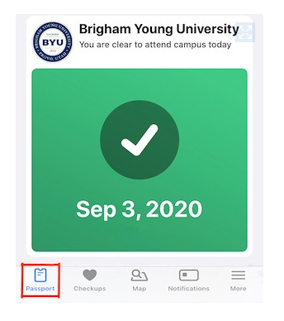
Symptom Checks
Please conduct a self-check for COVID-19 symptoms EACH day before you go to internship or campus.
BYU’s Healthy Together App

Slide 43
COVID-19 Notification
If you are experiencing COVID-19 symptoms, have been exposed to someone with COVID-19, have taken a COVID-19 test, or have been advised to leave your internship due to COVID-19 related issues, please immediately contact via email:
  Your Field Instructor
  Wendy Sheffield (BYU Field Director)
  Charlene Clark (School of Social Work Program Manager)
Depending on the situation, you may be asked to report your COVID-19 related situation at: BYU COVID-19 Self-Reporting Form

Slide 44
So….
What does this mean for you personally?

Slide 45
Required Field Forms
W
Legal forms (with FI signature) are submitted via IPT.
Forms without FI signature are submitted via Learning Suite.

Slide 46
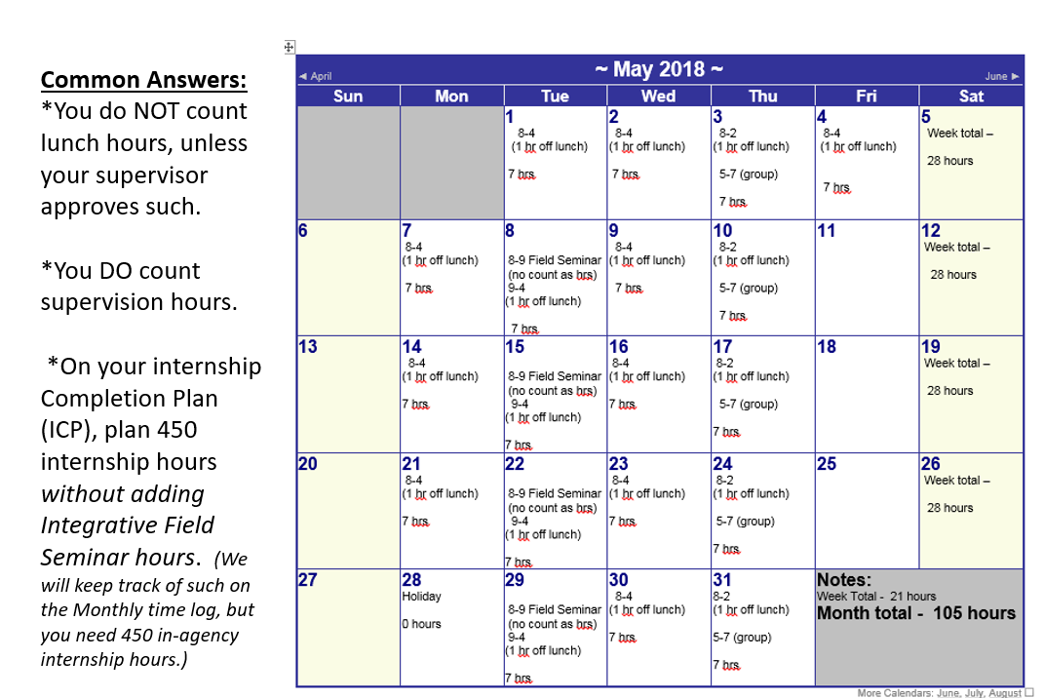
Internship Completion Plan
Your Internship Completion Plan
Outlines the specific days and hours
In which you will complete your
Internship.
Complete one for each Internship
Internship 1 ICP should cover from the end of April through Mid-August and total 450 hours.
Internship 2 ICP should cover from
September through Mid-April and total 600 hours.

Slide 47
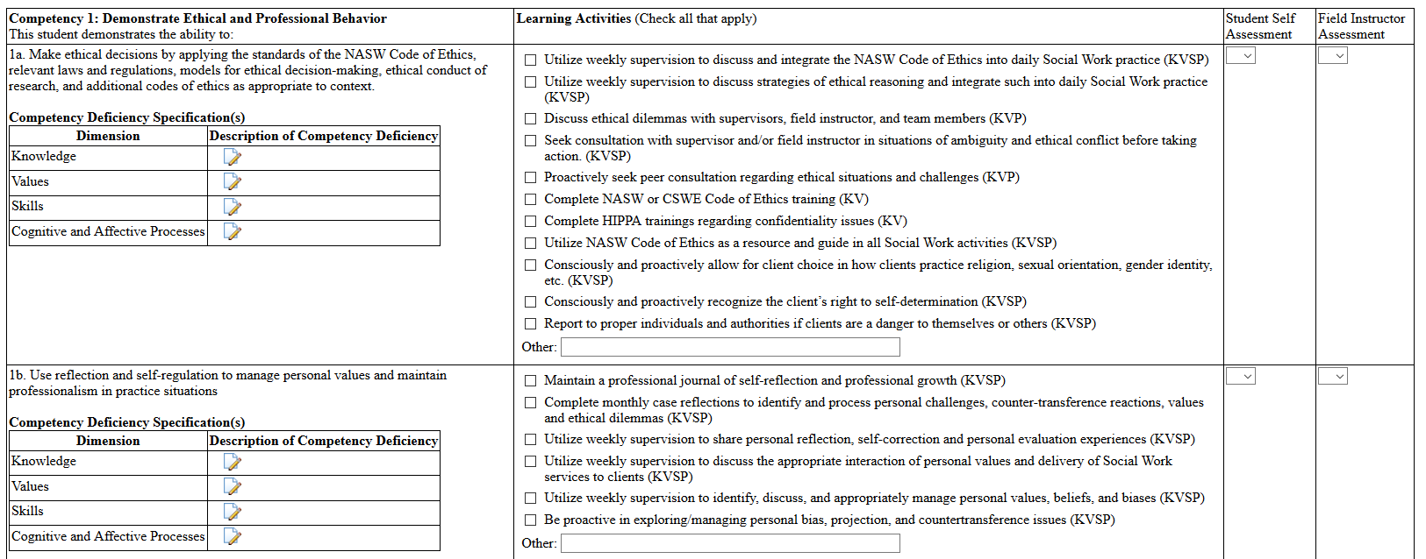
Learning Activity Agreement
Completed on IPT
Complete one each semester you are in an Internship.
Guides your internship activities and ensures competency development.
Specifies therapeutic activities covered under BYU’s professional liability insurance. Malpractice insurance is tied to your LAA and enrollment in 654R/655R. To ensure liability coverage, all therapeutic activities must be included in the LAA.
At least one activity must be checked for each practice behavior.
Do Not sign your LAA until your FI has reviewed it and made sure all the needed activities have been included.
Requires your signature, your FI signature, and the Field Director’s signature to be in force.

Slide 48
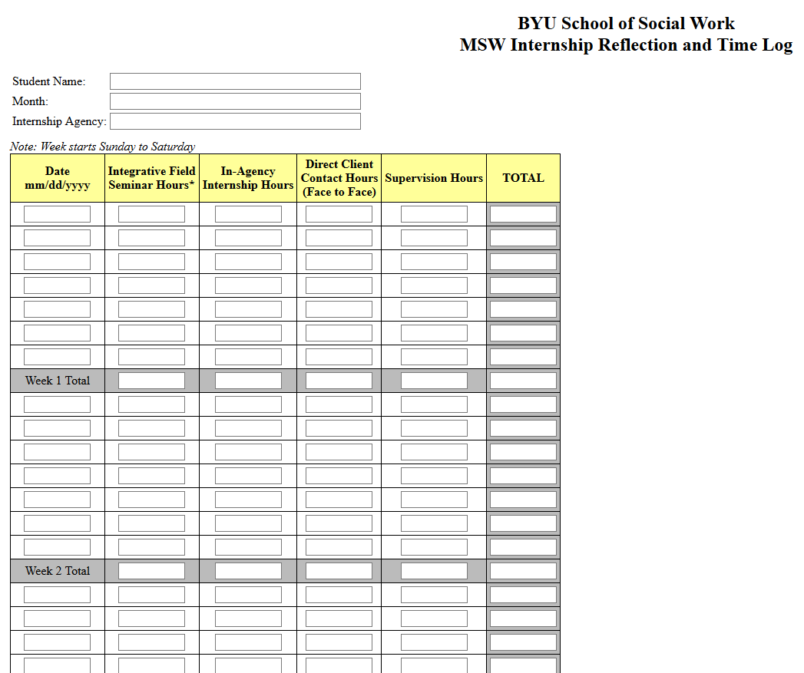
Monthly Time Sheet
Formally documents internship hours for graduation and licensure purposes
Formally documents supervision
Auto tallies hours
Maximize the number of Direct Client Contact Hours you receive in your internship
Scheduled and submitted via IPT
3 signatures required: yours, FI’s, and Field Director’s.

Slide 49
Reflection Questions and Responses
#1. Describe the internship activities you have performed during this month, and a success you have seen:
#2. What challenges have you experienced this month in your internship, and what steps have you taken to resolve those challenges?
#3. Please provide a case reflection from your internship that illustrates your internship activities, interactions, interventions, etc. Link your interventions to an evidence-based practice theory or modality. Full points require supporting specifics and details.
#4. How has your competency (knowledge, values, skills and cognitive/affective processes) as a social work practitioner increased this month? (Link your response to at least one of the nine CSWE competencies. Specify the Competency by number and topic. )

Slide 50
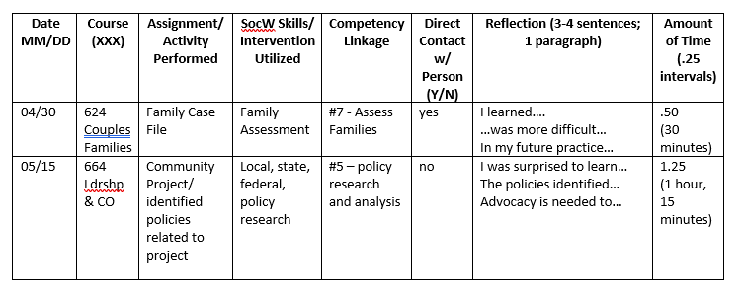
Monthly Simulation Log:
All remote field activities will be reviewed by a member of the field team for appropriateness of inclusion. Students will record and submit all remote field activities (other than Integrative Field Seminars and In-Agency Field Internship hours) on a Monthly Course-Embedded Simulation Log via the IPT system. To provide documentation of, and reflection upon, remote field activities the following will be included on the simulation log:
  associated SocW course
  assignment name/activities performed
  SocW skills and interventions utilized
  CSWE competency linkage
  Direct client contact
  time spent in the activity

Slide 51
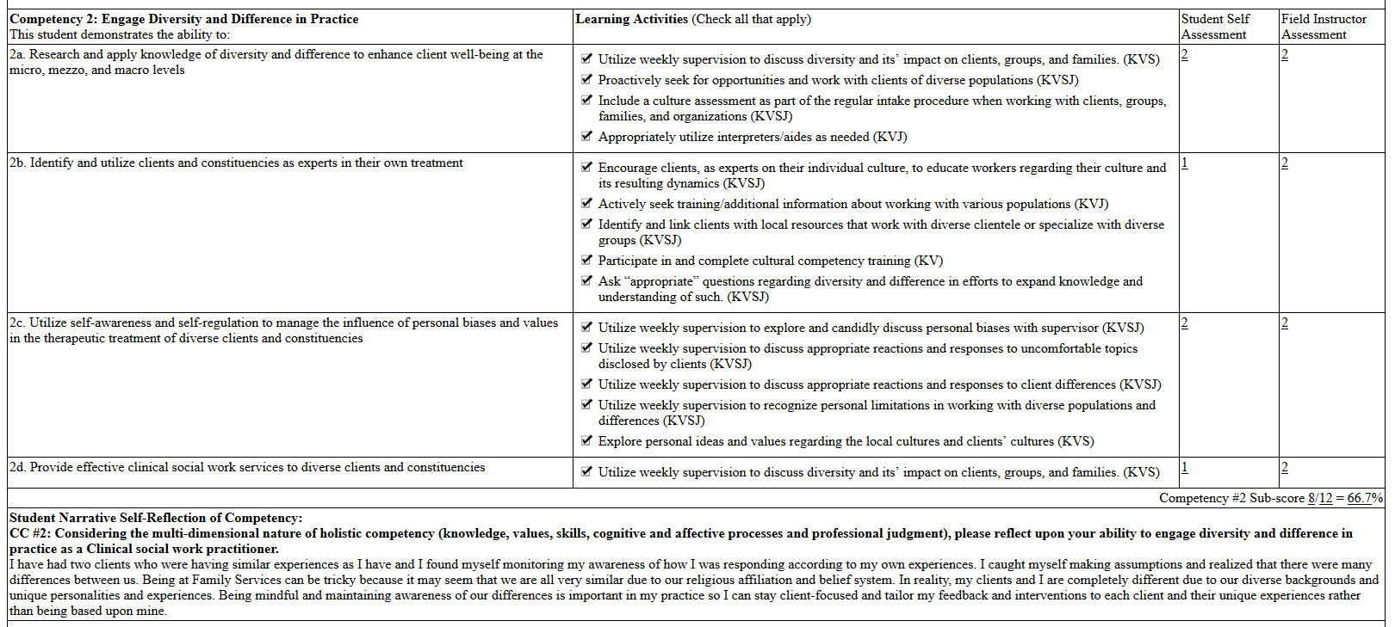
Final Evaluation
It is a dynamic form; the LAA must be signed before the Final Evaluation will be enabled.
Student scores and signs first, FI second, Field Director third.
See grading rubric in form for scoring assistance.
Sp/Sum: mostly 1s and 2s expected.
F/W (before graduating), mostly 2s and some 3s expected.
Complete at end of each semester.

Slide 52
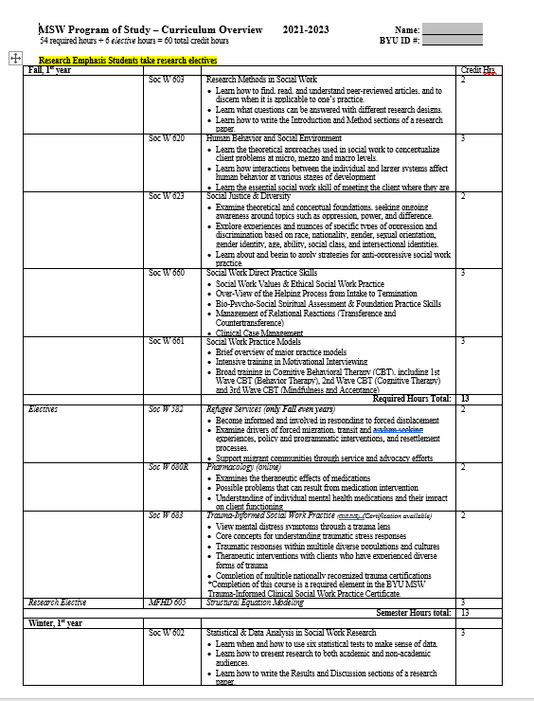
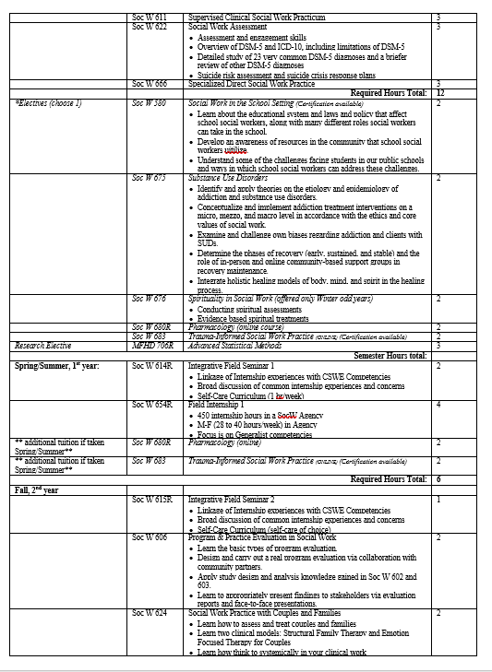
New Curriculum Chart

Slide 53
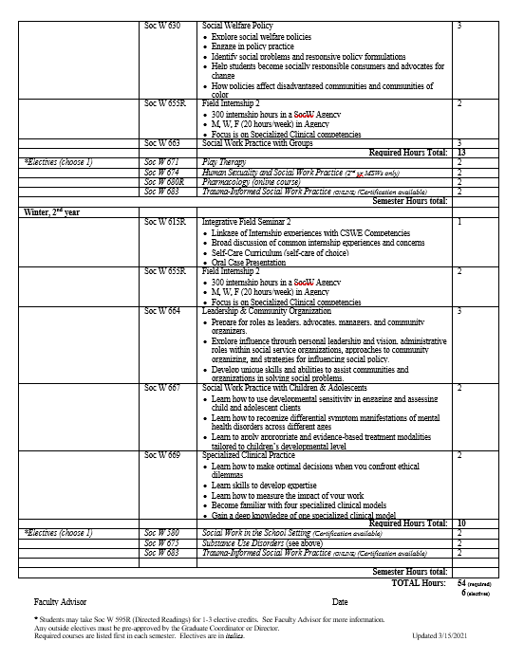

Slide 54
Safety Training
R

Slide 55
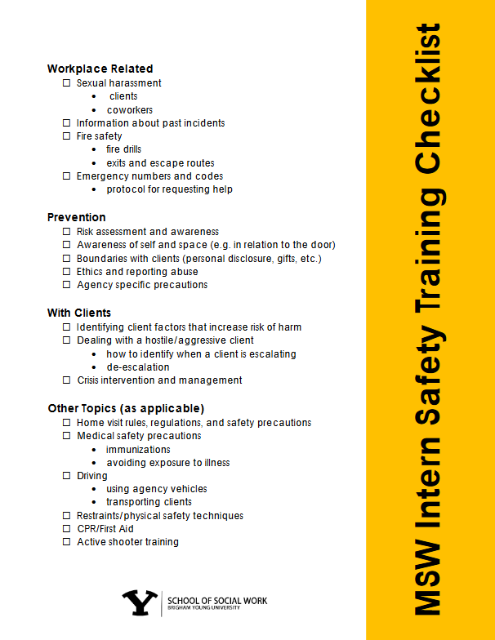
Safety Training Checklist
Found on Learning Suite
654R/655R Field Internship 1 & 2 Syllabi
Under the Content Tab
You have an assignment to review the Safety Training Checklist with your FI in each of your Internships.
Covers Safety Information specific to your Internship location/unit

Slide 56

20 to Ready!!
W

Slide 57
Orientation Checklist
R
Review Checklist with your Field Instructor

Slide 58


Slide 59

Safety Checklist for COVID-19
BEFORE
Confirm with your Agency what personal protective equipment (PPE) is required, and what your agency does/does not provide
Confirm agency safety protocols
Acknowledge potential anxiety/stress you may be experiencing, ask your FI any practical questions that may diminish safety concerns
Assess access to technology and reliability of that technology
Vaccination (as desired)
DURING INTERNSHIP
Review how to handle situations when client is not wearing mask, wearing mask improperly or takes off mask
Proactively bring concerns about interning during COVID-19 pandemic to your FI
Engage in self-care from day one in your internship (which is today!)

Slide 60
Field Liaison Visits
What to expect:
At least once each semester
In your internship agency
Will first meet with you
Will then meet with you and your FI
Important to be open and honest with strengths and concerns
Ruth will help problem solve as needed
More visits will be provided as needed

Slide 61
Scheduling Field Visits
Please help Ruth schedule the field visits with your Field Instructors

Slide 62
Self-Care Curriculum
W
Self-Care for Life = Life-Long Learning!

Slide 63
How personally valuable was the Self-Care Curriculum?
On a scale from 1 to 5, with 1 being low and 5 being high…

Slide 64
How professionally valuable was the
Self-Care Curriculum?
On a scale from 1 to 5, with 1 being low and 5 being high…

Slide 65
In your opinion, how important is the Self-Care Curriculum to your MSW education?
On a scale from 1 to 5, with 1 being low and 5 being high…

Slide 66
In your opinion, should Self-Care be included in the MSW Curriculum?
No or Yes

Slide 67

Self-Care Curriculum in IFS

Slide 68
Self-Care Curriculum
Each week we will either:
  *take a self-care assessment or
  *discuss a different form of self-care.
  *All handouts are under the 614R LS “Content” tab or online at the caps.byu.edu website, *“Stress & Biofeedback” section.
Weekly Intentional Self-Care Activities- submit via Learning Suite (614R/615R). Each week you will submit either:
  *one sentence indicating what you did for self-care that week,
  *or a picture of you/your self-care experience that week.
  *and a plan for what you will do next week for self-care (this helps make your self-care more intentional in nature).
Weekly Intentional participation is important (that’s the “regular” part…) Submissions are due each Saturday night.
Why assignments? No Guilt … Permission to practice!

Slide 69

Calm Mind; Calm Body

Slide 70

Mindfulness Exercises
Circle Breathing
Mindful Eating
Hi Chews
Mandarin Oranges
5-4-3-2-1

Slide 71
Supervision Suggestions & Topics
R
How to get the most from it…

Slide 72
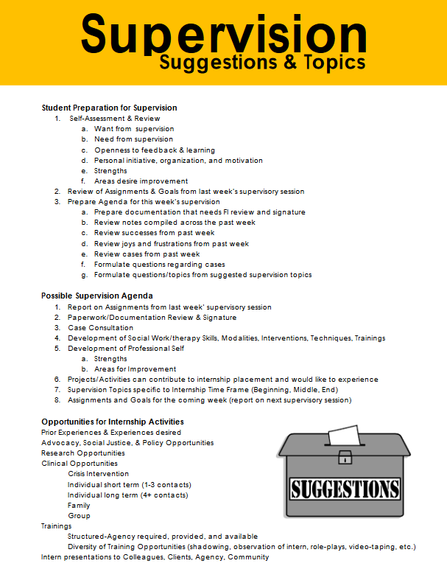
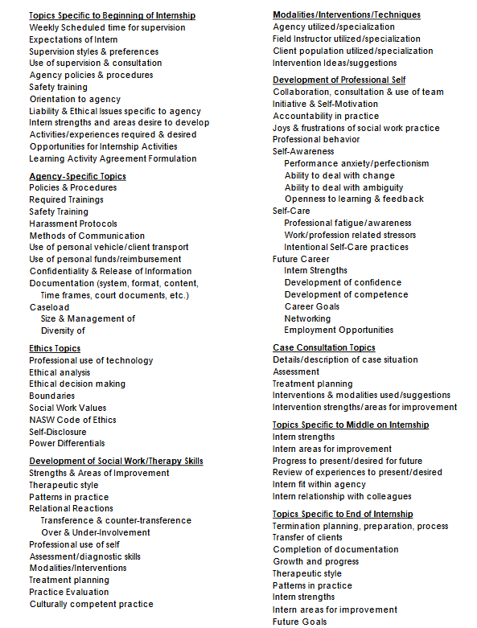

Slide 73
Flow of Internship
What you can expect and when…

Slide 74


Slide 75


Slide 76


Slide 77


Slide 78
Professionalism
&
Internship Success Tips
W

Slide 79

Do Get to Work On Time
R
Be where you are supposed to be, when you are supposed to be there, doing what you are supposed to be doing
Keep your supervisor informed of any change in your schedule.
BE SUPER DEPENDABLE

Slide 80

“I Need Your Signature”
Learning Agreement
Monthly Logs
Evaluations

Slide 81

Do Be Friendly
To the boss, the staff, the officers, the clients, the patients, the secretaries, the janitors… to EVERYBODY
Learn people’s names and what they do
Say “Good Morning” and “Good Night”

Slide 82

Do Be Willing To Work
No job is beneath you
Take your turn “scrubbing the toilet”
No one likes an arrogant therapist or social worker
Everyone starts climbing a ladder on the bottom step

Slide 83

Do Dress Appropriately for your Agency
Business Professional for some
Jeans for others
Ask your FI

Slide 84

Do Speak Up in Meetings
It is okay to appropriately advocate for your clients
It is okay to volunteer to take clients
It is okay to let secretaries know you are open to taking more clients

Slide 85

Do Accept Feedback
Being open to correction is a great way to learn
Acceptance and integration of feedback is central in educational and professional growth
Don’t be defensive when correction or feedback is given to you

Slide 86

Don’t Disappear
Don’t hide out in your office

Slide 87

Don’t Complain
Be willing to offer a solution

Slide 88

Don’t Get Pulled Into Drama
A staff member may cause you more difficulty than a client
Don’t allow yourself to be triangulated
“As an intern, I’m not in a position to comment on that.”

Slide 89

Field Instructors Aren’t Perfect
Replace judgment with curiosity
Trust your gut and be diplomatic
You learn as much from a poor example as you do from a good one

Slide 90
You Are Not #1
Don’t assume you are your Field Instructor’s main concern; they are often overwhelmed with work & usually underpaid
Be thoughtful of their time

Slide 91

Don’t Gossip
Always speak respectfully about clients & staff
Keep confidentiality
Be careful talking shop in a public place

Slide 92
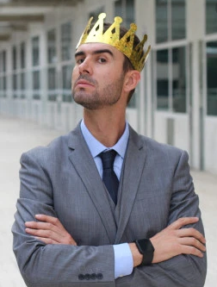

Don’t Be Arrogant
When you are in charge, you can do a better job

Slide 93

Don’t Dismiss Agency Policy
There is a reason they do things the way they do…
Ask: “what problem preceded this policy?”
Give candid, tactful feedback if asked

Slide 94

Be Professional in Word and Action
Bring concerns to your Field Instructor, Wendy & Ruth
Don’t discuss concerns with other agency personnel
Don’t speak negatively about your agency
Maintain confidentiality
Remember verbal, written, and technology considerations

Slide 95

Don’t Hold Onto Stress
Leave work at work
Let God take care of your clients
Practice Daily Self-Care
“Don’t Worry Alone;” discuss your concerns with your Field Instructor

Slide 96
Funding Options Review
C
Paid Internships are the #1 source of funding.
Don’t take this for granted!
AmeriCorps
Internship Grants
Other opportunities will be emailed to you
3MT and Shumway Paper
We will NOT remind you!
It is your responsibility to write the dates in your calendar now and submit them in a timely manner.
Thank You Letter and Report Requirement

Slide 97
Wrap Up Questions
W
???

Slide 98
That’s All Folks…
W
See you in Integrative Field Seminars!

Slide 99



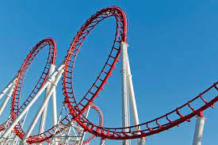
COVID-19 and Internships
Oh, what a ride it has been!

Slide 100
COVID-19 and MSW Field Education:
We are in a unique and unprecedented time in Field Education.
While we are making plans as if everything will "proceed without a glitch", it is possible this might not be the case.
In the case of unforeseen internship disruptions we will "pivot" and make changes as necessary.
We have put in alternatives in case of internship disruptions.
Remote Field Activities and Course-Embedded Field Related Assignments are to be recorded on Monthly "Simulation" Logs.
If needed, these hours might be counted toward your field education internship hour totals.

Slide 101
Field Education Adjustments due to COVID-19....
COVID-19 Safety Vetting of Internship Agencies: BYU’s field department has contacted all internship agencies to ensure that student safety will be maintained within internship placements. All agencies are meeting County, State, and National CDC guidelines. Telehealth is used whenever feasible. In those agencies where students are required to be onsite and work face-to-face with others, all are following the guidelines for: face masking, social distancing, sanitization, no visitation, and health assessment (questions, taking of temperature, etc.) of all employees who enter the premises on a daily basis. The field team will continue to monitor such on a weekly basis. All internships have been approved by the Dean of the College of Family, Home and Social Sciences, as well as an Associate Academic Vice President of the University.

Slide 102
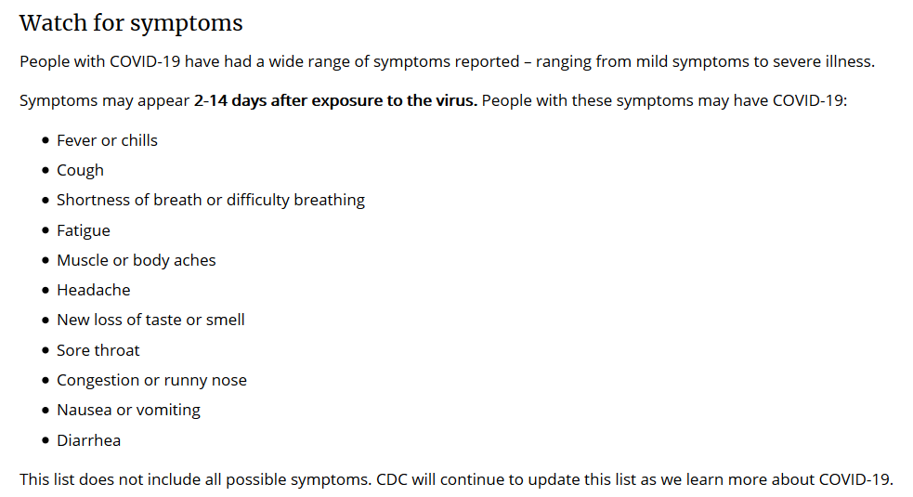
COVID-19 Symptoms

Slide 103

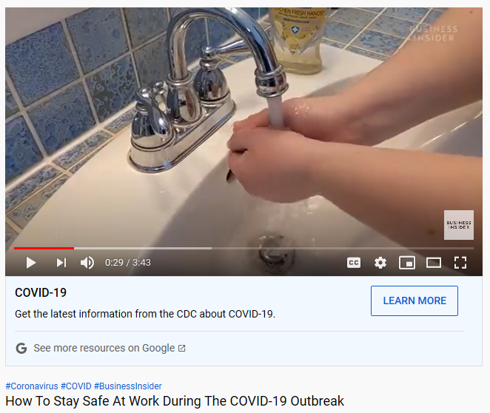
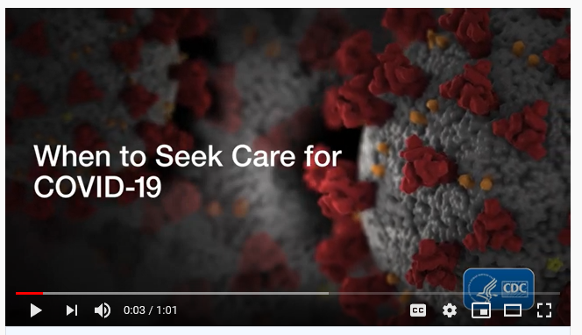
COVID-19 Safety Precautions:
  Wear a Mask
  Wash your Hands
  Social Distance
  Vaccination
  Healthy Together App
  Quarantine as necessary
  “Oh, be wise….”

Slide 104
More than ANYTHING else....
Make sure you take care of yourself Physically AND Emotionally!
  Take breaks from watching, reading, or listening to news stories, including social media if you are feeling overwhelmed or distressed.
  Eat healthy, exercise, get sleep and find time to unwind.
  Practice regular Self-Care!
  Talk with people you trust about your concerns and how you are feeling.
    As Dr. Wood says, "Never Worry Alone!"

Slide 105
Field Education Adjustments due to COVID-19.... (cont.)
If needed, BYU may be able to reduce its required field hours from 1050 to 900 for those who will be completing their MSW field internships by May 31, 2021. We hope we don’t have to do this!
Remote Field Activities have been developed and approved by CSWE as field hours if in-agency field internship hours are not possible.
If agency and remote field activities (see next slides) do not support 1050 hours of field education activities, the social work faculty may consider reducing the required field education hours to CSWE’s minimum of 900. We will make every endeavor to NOT reduce internship hours in order to provide our students with the best education possible.

Slide 106

Field Education Adjustments due to COVID-19.... (cont.)
Remote field activity. Although AS 2.2.4 requires field education through “in-person contact,” the Commission on Accreditation (has) broaden(ed) its interpretation to include remote-based field activity. Remote field activity can include engagement such as field-related assignments, trainings, and virtual meetings. Client-related virtual meetings should be in accordance with field site policies for secure communications.
(CSWE and Commission on Accreditation Statement, Update May 9, 2020, Alexandria, VA)

Slide 107
BYU has developed and approved the following as Remote Field Activities:
Integrative Field Seminars (IFS): IFS will be held weekly via Zoom and will focus upon the integration of Social Work theory, MSW program of study course content, field-related social work activities, and CSWE competencies. (Competency 1-9)
Tele-health Activities as approved by individual agency internships and following all field site policies and utilizing secure communications (HIPPA compliant). (Competency 6,7,8,9)
Course-Embedded Field-Related Assignments: MSW Social Work courses (required and elective) are encouraged to include assignments with field-related components. These assignments may include any activity in which an MSW student could participate during an internship placement. (Competency 1-9)

Slide 108
Remote Field Activities (cont.)
Virtual Field-Related Trainings: Student participation in online trainings regarding internship procedures, policies, and management; supervision; skills training, trainings that will benefit the internship agency (specialized treatment, self-care, ethics, etc.), or specialized clinical training will count as remote field activities. (Competency 1-9)
In order to be considered as a CLINICAL field-related training, social work practice skill development must be included within the course content. (Competency 6,7,8,9)
Community Outreach Projects: Students may participate in Community Outreach Projects to benefit the community using their MSW training and skills. All such projects must be linked to a social work course or a therapeutically related AmeriCorps activity. (Competency 1-9)

Slide 109
Remote Field Activities (cont.)
Curriculum Development: Develop curriculum for agency Groups/Workshops for future implementation with clients (ex. Life-skills, grief, trauma, domestic violence, etc.) (Competency 6,7,8,9)
Written Materials for Agency, Clients, or Community: Develop handouts/flyers/brochures (ex. Explain client rights, informed consent policies, language translation, etc.) (Competency 1-9)
Organizational Policy Review: Review agency policies with suggestions/recommendations where appropriate (ex. Safety policies (including COVID-19, natural disasters, etc.), diversity policies, use of social media, utilization of technology, etc.) (Competency 1-9)

Slide 110
Remote Field Activities (cont.)
Legislative Policy Review: Review relevant laws and policies impacting the population students work with (ex. Indian Child Welfare Act, Emergency Mental Health Holds, Homeless Policies, Refugee and Immigrant Policies, etc.) and provide a synopsis of key takeaways or prepare advocacy materials. (Competency 5)
Literature Review: Conduct a literature review on a specific topic relevant to the internship placement agency. (ex. Effectiveness of an interventions, how interruption of services impacts mental health or economic stability, etc.) (Competency 4)
Grants: Research potential grant opportunities and/or prepare aspects of the grant writing. (Competency 1-9)

Slide 111
Remote Field Activities (cont.)
Complete online trainings relevant to the practicum and social work practice: Complete assigned trainings from field instructor and provide: a certification of completion, a short written reflection, and/or prepare a presentation to disseminate the knowledge gained to others within the agency. (Competency 6,7, 8, 9)
Community Networking/Resource Development: Teleconference with various service providers, participate in resource mapping, develop a list of resources for clients with services offered, referral process, documentation needed, etc. (Competency 1, 2, 3, 4, 6, 7, 8)

Slide 112
Additional Remote Field Activities
Field Instructors, Task Supervisors, or Social Work Course Professors may develop additional activities or trainings in addition to those listed here. It is the student’s responsibility to ensure that all field-related activities are pre-approved by their Integrative Field Seminar Instructor. (Competency 1-9)

Slide 113
Monthly Simulation Log:
All remote field activities will be reviewed by a member of the field team for appropriateness of inclusion. Students will record and submit all remote field activities (other than Integrative Field Seminars and In-Agency Field Internship hours) on a Monthly Course-Embedded Simulation Log via the IPT system. To provide documentation of, and reflection upon, remote field activities the following will be included on the simulation log:
  Associated SocW course
  Assignment name/Activities performed
  SocW skills and interventions utilized
  CSWE competency linkage
  Direct client contact (CSWE requires)
  Time spent in the activity

